Slide 1

Web-Based Student-to-Supervisor Allocation and Assessment System
PREPARED BY: RICHARD EGHENAYARHIORE EMMANUEL (CST20HND0558)
SUPERVISED BY: MR. ADEOYE, BAMIDELE ADEDAYO

Slide 2
Table of Content
1
Background of the Study
2
Statement of the Problem
3
Aims and Objective of the Study
5
Summary of Literature Review
6
Research Methodology
4
Significance of the Study
7
System Modeling
8
Proposed Interface Design
9
Summary / Conclusion
Presentation Title

Slide 3

Background of Study
Since the inception of the Computer Science department, assigning students to supervisors and assessing student projects and seminars is done manually. Assessment of students is done in two ways, the student supervisor would assess the student as well as the panel which would access the student twice; namely the seminar and final defense assessment. This is done to ensure that the student carries out their project themselves or participated, which will then be used to grade them. The assessment sheet has to be printed in copies by the student depending on the number of assessors in that particular venue, similarly, with assigning students to supervisors, considering the number of students is not easy to assign and group students probably using excel, it is monotonous and quite inefficient.
This approach has been taken repeatedly over the years and causes a lot of paperwork with the possibility of poor documentation. This study will develop a student-to-supervisor allocation and assessment system that will be used by the department in assessing student project and seminar defense, thereby increasing work efficiency among project coordinators and defense panelists.
The system uses an algorithm to automatically assign students to a supervisor, which creates an avenue where students can easily find the supervisor's contact information for ease of communication

Slide 4

Statement of the problem
It has been a mere saying that students are to be allocated to supervisor on time but the reverse is the case due to the series of monotonous activities involved in the process, not enough time is given to the student in completing the project, even when allocated student find it difficult in reaching out to the supervisors, a student would deliberately refuse to come for the defense until the last day increasing workload for the assessors. A lot of paperwork is involved in assessing students both in the seminar and project defense, which if not well documented may lead to incorrect grade input for that particular student, the highlighted problems jogged my interest to embark on the project

Slide 5



Aim and Objectives of the Study
Aim
To develop a student-to-supervisor allocation and assessment system for the computer science department at Kaduna polytechnic
Objectives
Student and supervisor data sets will be extracted from the department depending on the student that qualified for that year’s project as both the student and supervisors are not to perform registration on the site. The registration is automated
Django which is a high-level python web framework will be employed in the backend development, Modern technologies like HTML, CSS, and JavaScript will be employed in front-end development, and open-source relational database; MySQL will be employed as the database technology

Slide 6

Significance of Study
This study would increase the drive for improvement in such a way that it will provide an avenue for other parts of a project management system to be included. It is carried out to eliminate time wastage in allocating students to their various supervisors, thereby providing a secure way for the higher institution of learning to create and manage the data related to student-supervisor relationships, as well as providing a platform where assessors can assess student project and seminar defense and manage the data efficiently.

Slide 7
Summary of literature review
Title | Author & Year | Description | Merit | Demerits
Design and Implementation of Students’ projects allocation system. | Amadi et al. (2021). | This study focuses on building and implementing a software system for allocating student projects (dissertations) | The system allocates a project to the student based on the highest score awarded by the supervisor to the student's. | The system might lack scalability, high influx of users (students) might make the site slow.
Final Year Student Project Allocation Archiving and Management System. | Adamu A., (2020). | This study tackles its stated problems by establishing a final-year student project allocation, archiving, and management system in which the supervisor and student may engage in real-time checkmate for project approval and submission | Real-time project approval and submission. | Security threat as users’ information is stored in its session as long as possible unless they are manually logout.

Slide 8
Summary of literature review
Title | Author & Year | Description | Merit | Demerits
Academic Project Information Management System. | Arumugam et al. (2021) | This article describes an automated approach for managing final-year projects and also how a web-based automated system would resolve all faults and mistakes while remaining operational offline | As an automated system, it reduces the chances of errors that occur when records are been updated. | The implemented system is a local host platform, which is not ideal for any project unless under development.
E-Assessment in Higher Education: Student’s Perspective. | Huda et al. (2020). | This study investigates the use of e-assessment in higher education from the standpoint of students, as well as the. | The study is based on the thoughts of a small sample of university students chosen at random, each of whom had a different reaction to e-assessment. | Some students acknowledge the need for e-assessment, but they are anxious about technology-based tests since not all of them have the same level of IT proficiency.

Slide 9
Summary of literature review
Title | Author & Year | Description | Merit | Demerits
A preemptive goal programming for allocating students into academic departments of faculty | Hassan (2016). | The study focuses on creating a goal programming model to maximize the placement of students in a faculty's academic departments. | A major strength of goal programming is its simplicity and ease of use. | A debated weakness is the ability of goal programming to produce solutions that are not Pareto efficient. A debated weakness is the ability of goal programming to produce solutions that are not Pareto efficient.
Design and implementation of student project management and allocation system. | Ojo et al. (2022) | This project aims to create a web-based system that handles the activities of "student Project Management and Allocation." | An ideal set of programming languages was used in implementing the system. | Final-year students have to register on the site themselves which implies that anyone can register on the site and the allocation process is not automated.

Slide 10
Summary of literature review
Title | Author & Year | Description | Merit | Demerits
E-Assessment in Higher Education: A Review | Martin and Fanus (2018) | The purpose of this research is to give a discussion on e-assessment that focuses on ideas such as tasks that may be obtained through e-assessment, benefits and problems of e-assessment, and e-assessment principles | E-assessment can be beneficial provided the assessment is credible and lecturers work together to develop authentic, consistent, transparent, and practicable assessments.
Web-based project assessment | Supianto and Khaerudin. (2020). | The goal of this research is to perform a review of the literature on project-based learning and assessment | The research showed that web-based assessment is more flexible, reduces paper consumption, and data collecting, and encourages e-learning | Other hurdles revealed by the research include the visual style of the internet interface, which may pose problems for its users

Slide 11

Research methodology
Choice of programming language
Method of data collection
This research work will be a web-based application and will be implemented on a relational database system (SQLite). HTML (hypertext markup language), CSS (cascading style sheet), and JavaScript for the frontend development while Django (Python) will be employed for the backend programming
Before developing any system, collecting data and facts about the existing system is critical to understand what is going on. This research was carried out using three methods.
Observation of the Work Environment
Documentation
Interview

Slide 12
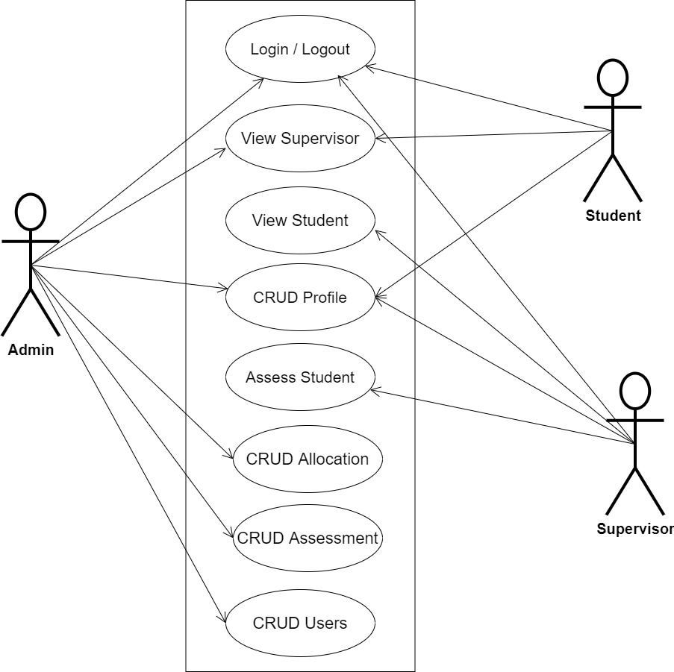
System Modeling (Use Case Diagram)
System Use Case Diagram

Slide 13
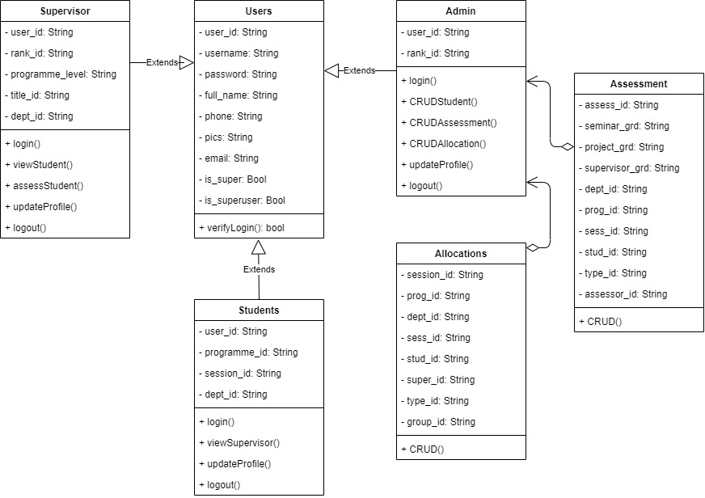
System Modeling (Class Diagram)
System Class Diagram

Slide 14
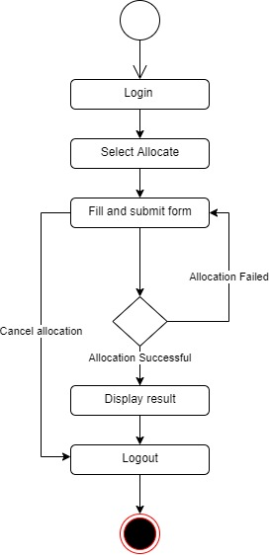
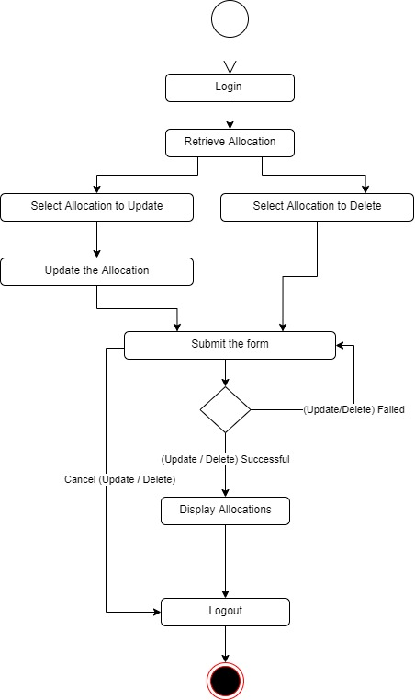
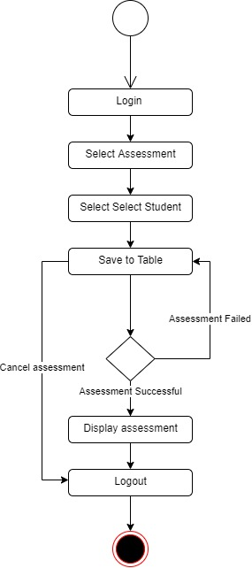
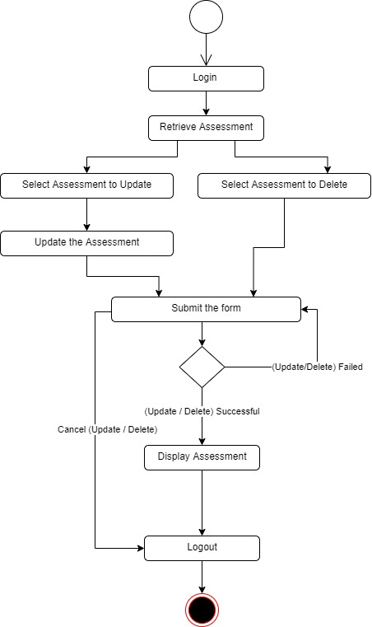
System Modeling (Activity Diagram)
Create Allocation
Update/Delete Allocation
Create Assessment
Update/Delete Assessment

Slide 15
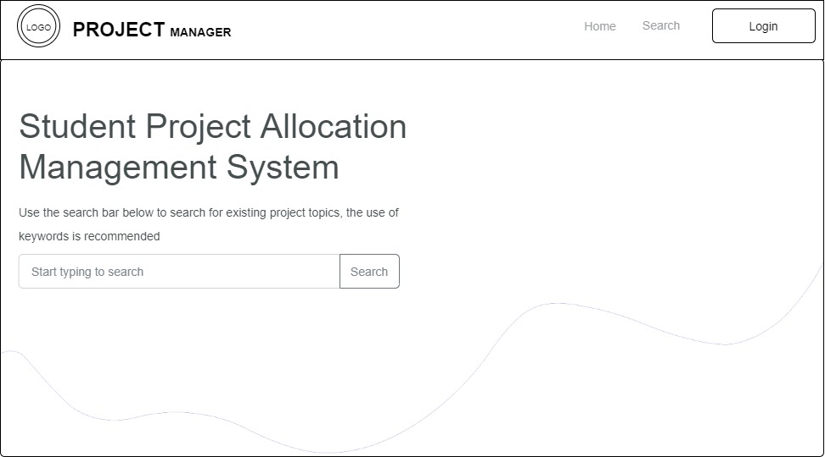
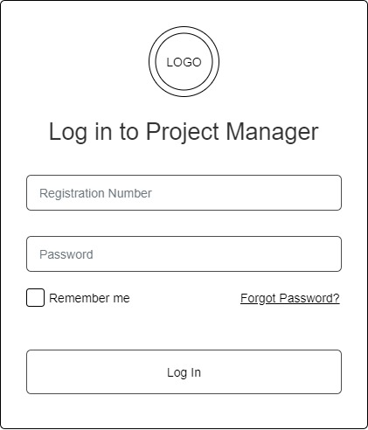
Proposed Interface Design
Homepage
Login page

Slide 16
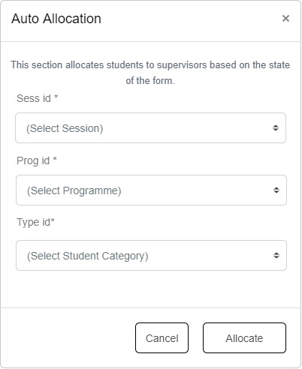
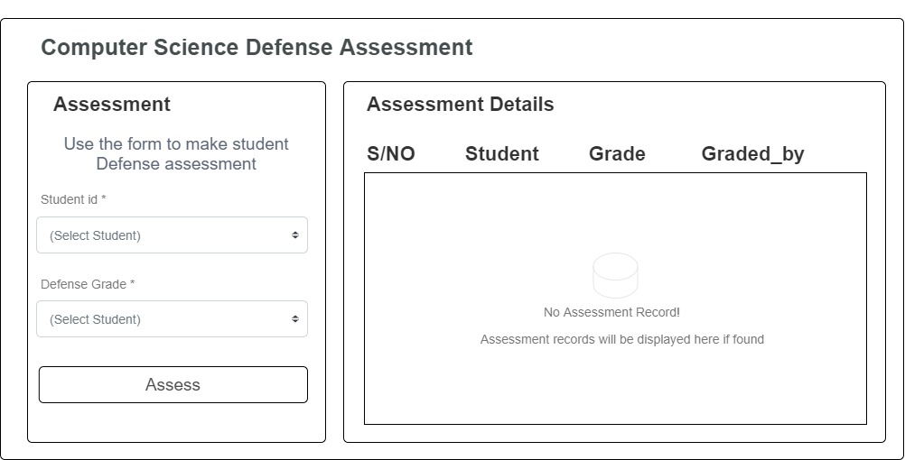
Proposed Interface Design
Defense Assessment Screen
Student-to-supervisor allocation form

Slide 17

Summary
This research work is centered on the development of an algorithm for assigning students to supervisors and assessment of student seminars and project defense, as well as the development of a user-friendly, web-based interface to serve its purpose and implementation of the system and evaluation of its effectiveness. It will not cover the overall functionality of a project management system, including submitting project topics for approval and others
This study would increase the drive for improvement in such a way that it will provide an avenue for other parts of a project management system to be included

Slide 18

Thank you

